Slide 1
Data structure and algorithm

Slide 2
Data structure and algorithms
Data structure is the logical or mathemathical model of particular organization of data.
It is a construct that can be defined within a programming language to store collection of data.
Data structures are of two types:-
Linear Data Structures
Non-Linear (linked) data structures

Slide 3
Linear Data Structures:-
Linear data structures are the collections of components arranged straight line.
When we add new component or remove existing components linear data structures grow or shrink.
Ex:- of linear data structure are stack and queue.

Slide 4
Non-Linear (linked) data structures
Non-linear data structures require separate blocked of storage together using pointer.
A pointer is a memory location of a black of storage.
following the pointers we can travel along an access path contained in a non-linear data representation.
Ex:- non-linear data structures are trees and graphs.
The study of data structure involves:-
To identify and develop useful mathemathical entities and operation.
To determine what classes of problem can be solved by using these entries and operations.

Slide 5
WHAT IS A DATA?
Any value or set of values is referred as data.
A data item refers to single unit of value. Also called as elementary data item.

Slide 6
Data :- collection of fact and figures.
Any data item that consists of more than one elementary data item is referred as group data item.
Field contains data.
Set fields any of entity is called record.
Set of record is referred as database.
Field is also called attribute of entity.
The end product of data processing is information.
the processeddata is called information.
The unit of information is bit.
One bit represents “on “ and “off” position of bit.
Data structure is logical or mathemathical model of a particular organization of data.
The data should be simple to process whenever necessary

Slide 7
Ex:-
Entity:-
Student,book,employee,item
Elementary data item:-
Rollno,marks salary ,item_code.
Grouped data item:-
Fullname,date_of_birth,Dt_joining.

Slide 8
Data types:-
Each variable in algorithm has a data type.
Data type determines the code for storing data.
Following four categories:-
1)character:-
It this type data is coded using some character code like ASCII or EBCEIC.
A single character is normally stored in a byte.
2)real:
This is numeric data type using the exponential form.
This represents floating point numbers.
3)integer:
This is also a numeric data type that holds flxed-point numbers.
4)logical:
This is special data type that cantains only the values true or false.

Slide 9
WHAT IS OPERATIONS?

Slide 10
Data structueres are processed by certain operations.
All type o operations is not possible with every data structure.
Following the main operations that play major role in data structure.

Slide 11
1)Traversing:- this is the process of accessing visiting every element of structure exactly once.
2)Searching:- this means to find the location of the element with given key value in the data structure.
3)Inserting:- this means to add a new element in the structure at given location.
4)Deleting:- this refers to removing an element from the data structure.
Following two operations are used in special situation.
1)Sorting:- this means to arrange the element in data structure In some logical order ascending (increasing) or descending (decreasing) depending on key value of element.
2)Merging:- this operation combines the element in ttwo different sorted strutures into a single sorted structure.
Others data structure operations are
1)Copying:-this means to copy the element of one structure into another data structure.
2)Concatenation:- this operation combines elements of two structures (need not be sorted) into another data structure.

Slide 12
Data structure types:

Slide 13
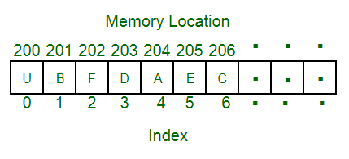
Array Data Structure
An array is a collection of items stored at contiguous memory locations. The idea is to store multiple items of the same type together. This makes it easier to calculate the position of each element by simply adding an offset to a base value, i.e., the memory location of the first element of the array (generally denoted by the name of the array).
he above image can be looked as a top-level view of a staircase where you are at the base of the staircase.

Slide 14
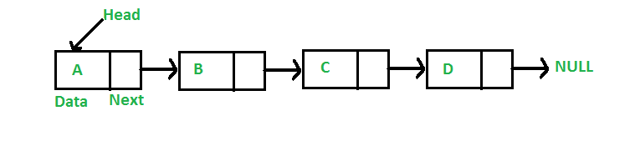
Linked List Data Structure
A linked list is a linear data structure, in which the elements are not stored at contiguous memory locations. The elements in a linked list are linked using pointers as shown in the below image:
In simple words, a linked list consists of nodes where each node contains a data field and a reference(link) to the next node in the list

Slide 15
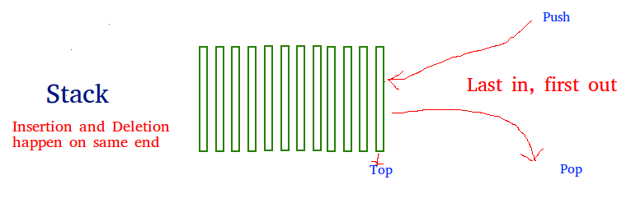
Stack Data Structure
Stack is a linear data structure which follows a particular order in which the operations are performed. The order may be LIFO(Last In First Out) or FILO(First In Last Out).
There are many real-life examples of a stack. Consider an example of plates stacked over one another in the canteen. The plate which is at the top is the first one to be removed, i.e. the plate which has been placed at the bottommost position remains in the stack for the longest period of time. So, it can be simply seen to follow LIFO(Last In First Out)/FILO(First In Last Out) order.

Slide 16
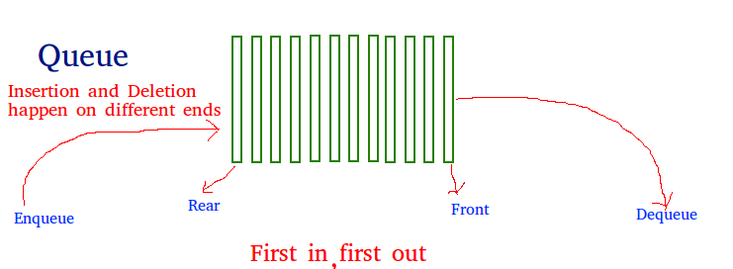
Queue Data Structure
A Queue is a linear structure which follows a particular order in which the operations are performed. The order is First In First Out (FIFO). A good example of a queue is any queue of consumers for a resource where the consumer that came first is served first. The difference between stacks and queues is in removing. In a stack we remove the item the most recently added; in a queue, we remove the item the least recently added.

Slide 17
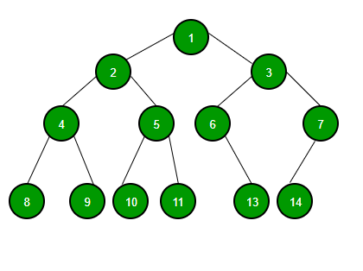
Binary Tree Data Structure
A tree whose elements have at most 2 children is called a binary tree. Since each element in a binary tree can have only 2 children, we typically name them the left and right child.
A Binary Tree node contains following parts.
Data
Pointer to left child
Pointer to right child

Slide 18
Binary Search Tree
Binary Search Tree is a node-based binary tree data structure which has the following properties:
The left subtree of a node contains only nodes with keys lesser than the node’s key.
The right subtree of a node contains only nodes with keys greater than the node’s key.
The left and right subtree each must also be a binary search tree.

Slide 19
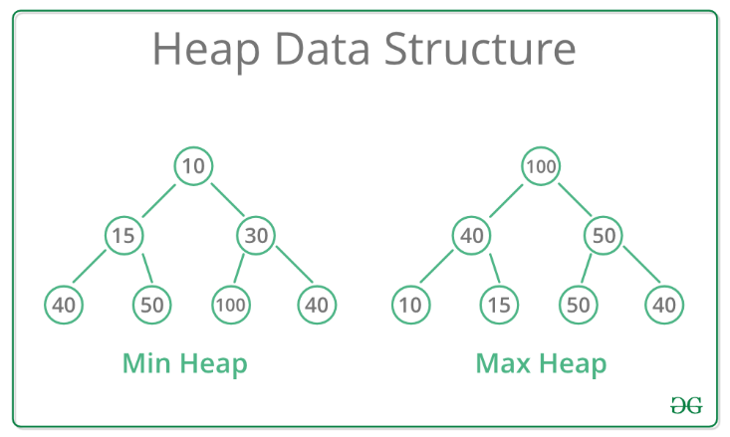
Heap Data Structure
A Heap is a special Tree-based data structure in which the tree is a complete binary tree. Generally, Heaps can be of two types:
Max-Heap: In a Max-Heap the key present at the root node must be greatest among the keys present at all of it’s children. The same property must be recursively true for all sub-trees in that Binary Tree.
Min-Heap: In a Min-Heap the key present at the root node must be minimum among the keys present at all of it’s children. The same property must be recursively true for all sub-trees in that Binary Tree.

Slide 20
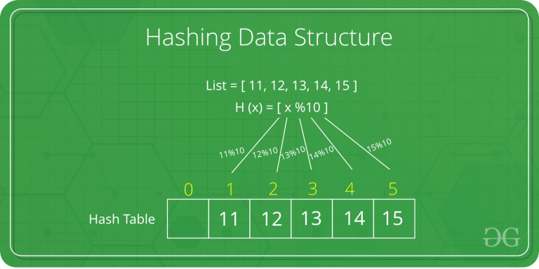
Hashing Data Structure
Hashing is an important Data Structure which is designed to use a special function called the Hash function which is used to map a given value with a particular key for faster access of elements. The efficiency of mapping depends of the efficiency of the hash function used.
Let a hash function H(x) maps the value
at the index x%10 in an Array. For example if the list of values is [11,12,13,14,15] it will be stored at positions {1,2,3,4,5} in the array or Hash table respectively.

Slide 21
Graph Data Structure And Algorithms
A Graph is a non-linear data structure consisting of nodes and edges. The nodes are sometimes also referred to as vertices and the edges are lines or arcs that connect any two nodes in the graph. More formally a Graph can be defined as,
A Graph consists of a finite set of vertices(or nodes) and set of Edges which connect a pair of nodes.

Slide 22
END

